Slide 1



Deep learning using TensorFlow Session1

Slide 2
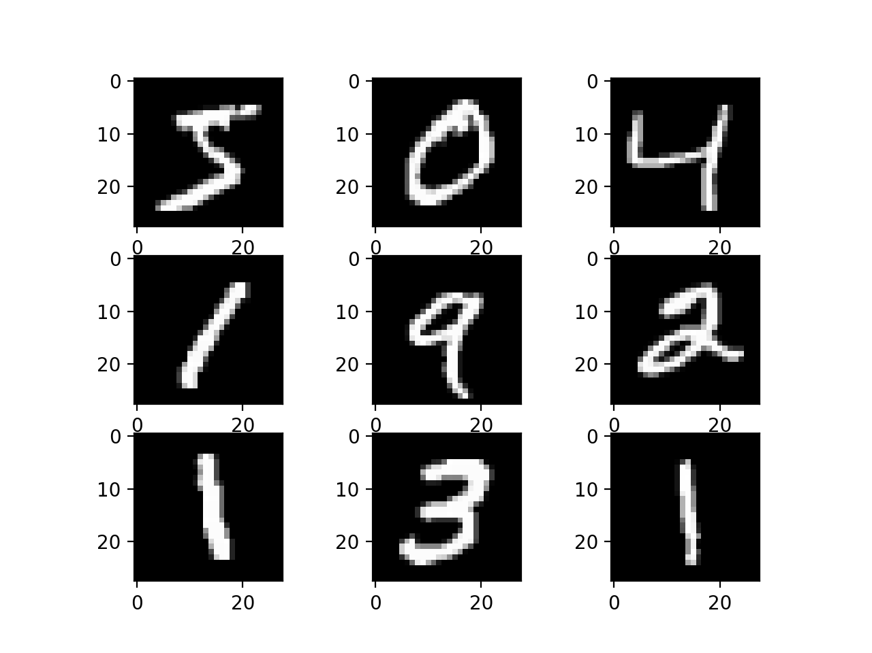
A problem
https://www.tensorflow.org/tutorials/quickstart/beginner

Slide 3
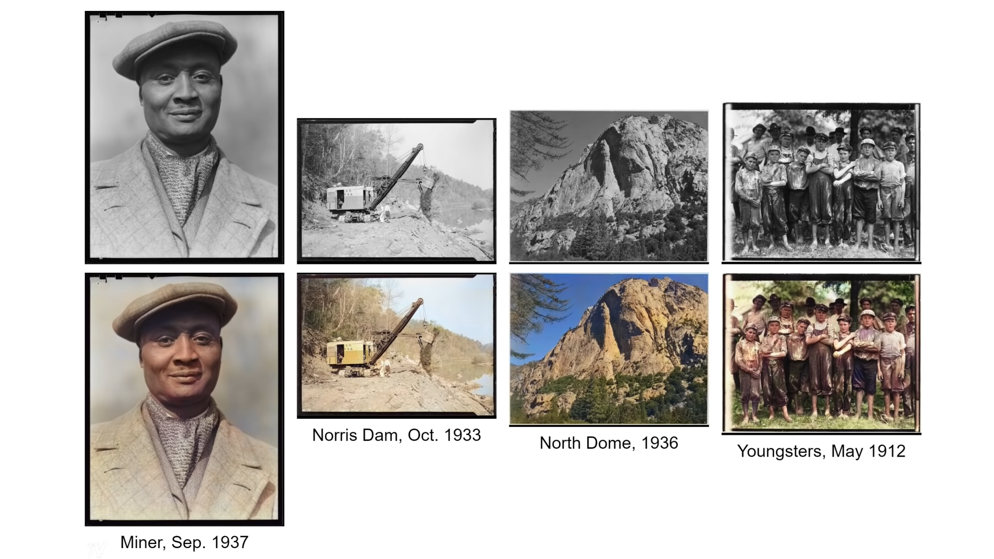
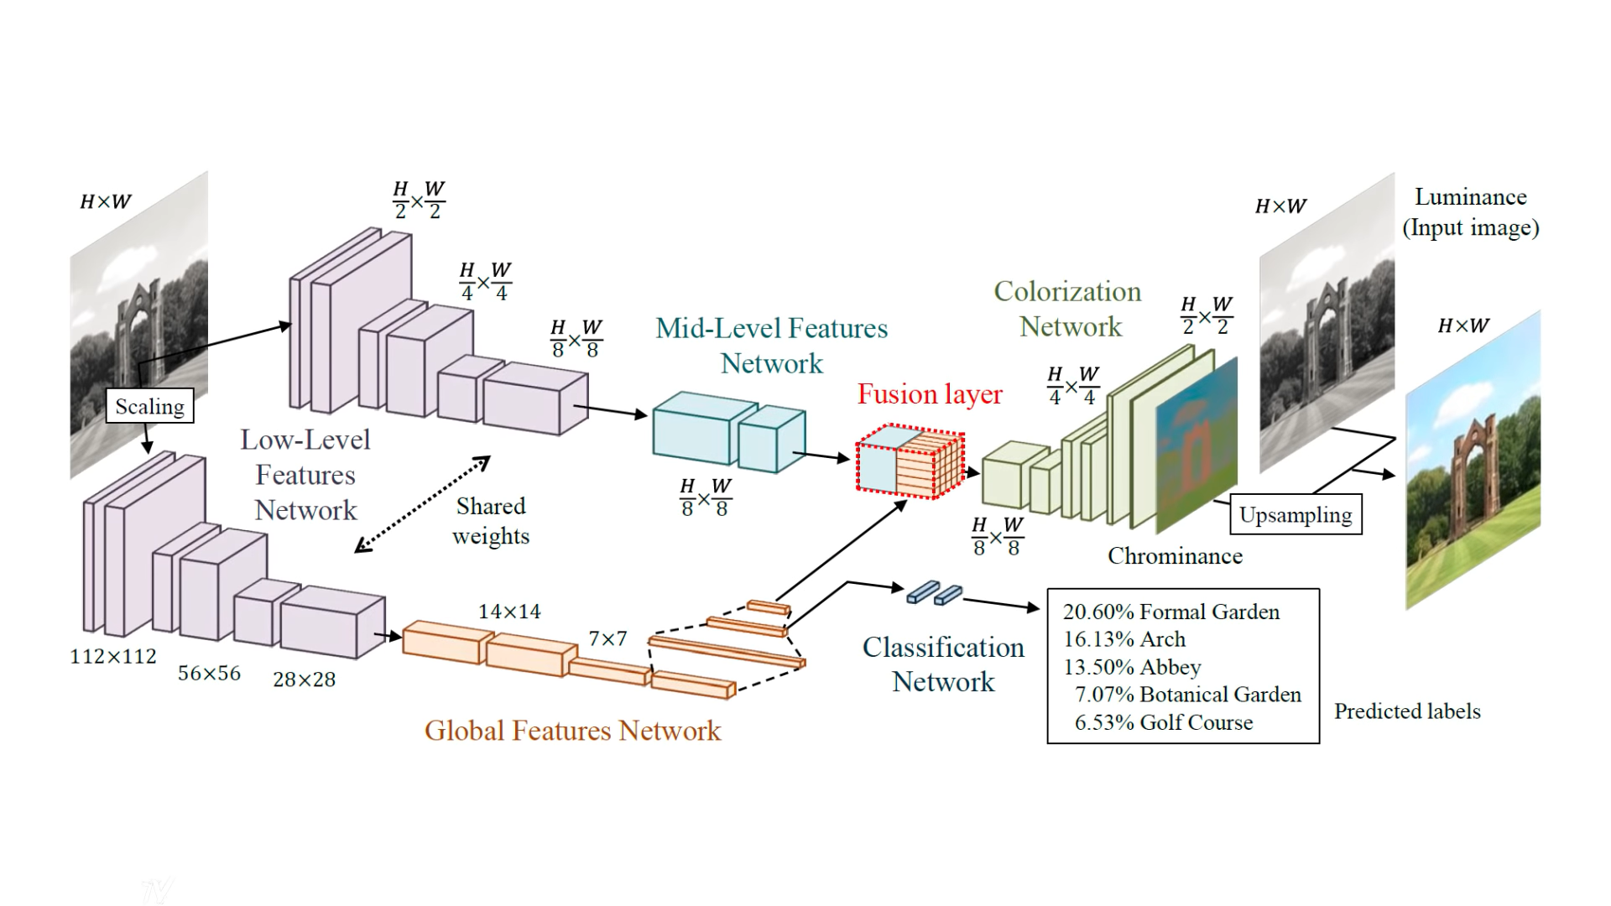
A lot of cool applications

Slide 4
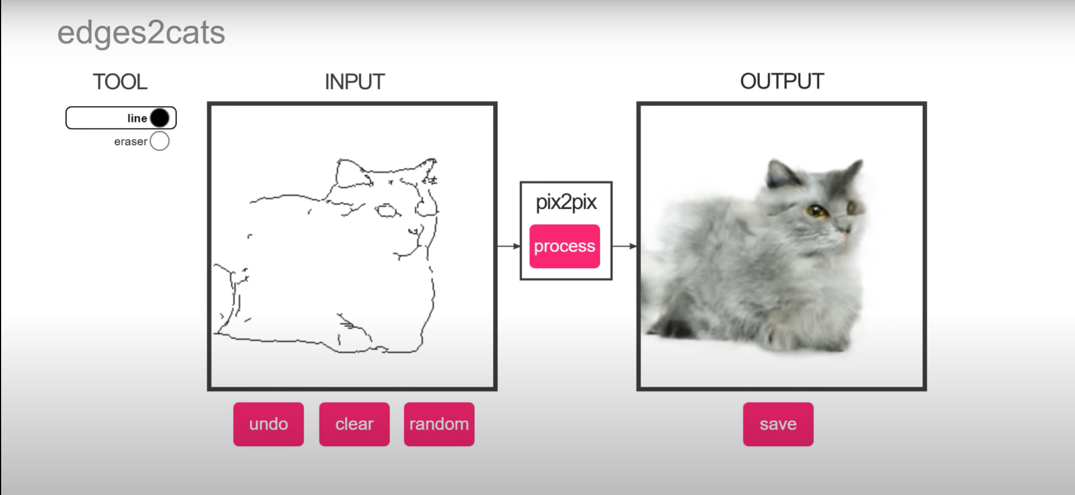
A lot of cool applications

Slide 5
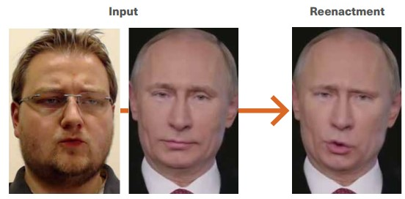
A lot of cool applications

Slide 6


What are these sessions about?
- A very simple introduction to the theory behind deep learning.
- How to start applying using TensorFlow
Not that dramatic,
But the basics to make it that dramatic later
- The structure of machine learning projects
- Intro to CNNs for Computer Vision using tf
- Some small projects using tf

Slide 7

01
Spoilers alert!

Slide 8

Table of Contents!
Session 2
Session 1
Session 3
Preprocessing using NumPy and Pandas.
Intro to Computer Vision techniques.
Computer vision mini project.
Intro to machine learning.
Linear regression.
Intro to deep learning.
Mini project.
Transfer learning
Project using transfer learning(or according to our agreement)

Slide 9


Introduction
ML
DL
What is the difference between AI, Machine learning and Deep learning?
AI

Slide 10
AI
AI: AI is a bigger concept to create intelligent machines that can simulate human thinking capability and behavior, whereas, machine learning is an application or subset of AI that allows machines to learn from data without being programmed explicitly.
ML
DL

Slide 11
We are interested in ML and deep learning.
Inputs
Logic
Outputs

Slide 12
TensorFlow

Slide 13
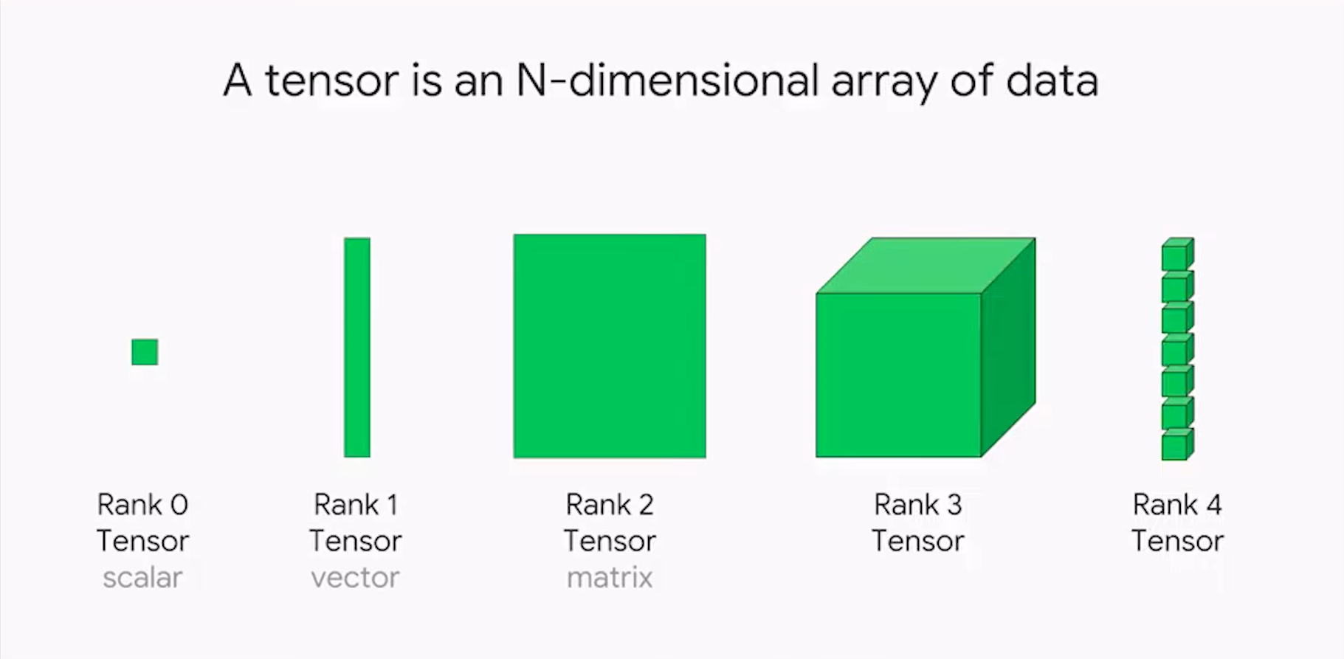

Slide 14
Tensors notebook:
https://drive.google.com/file/d/1j5sjtozR6MK_mYaM7lVQlaFzS9Hrkaa7/view?usp=sharing

Slide 15
Tensors are tiny blocks in understanding TF
The most important part is to understand deep learning itself

Slide 16
A step back before deep learning

Slide 17
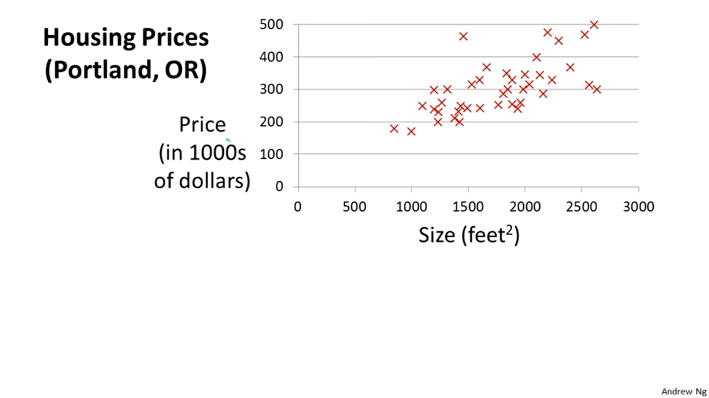
We have a problem.
We want to know the prices of apartments with respect to their size.

Slide 18
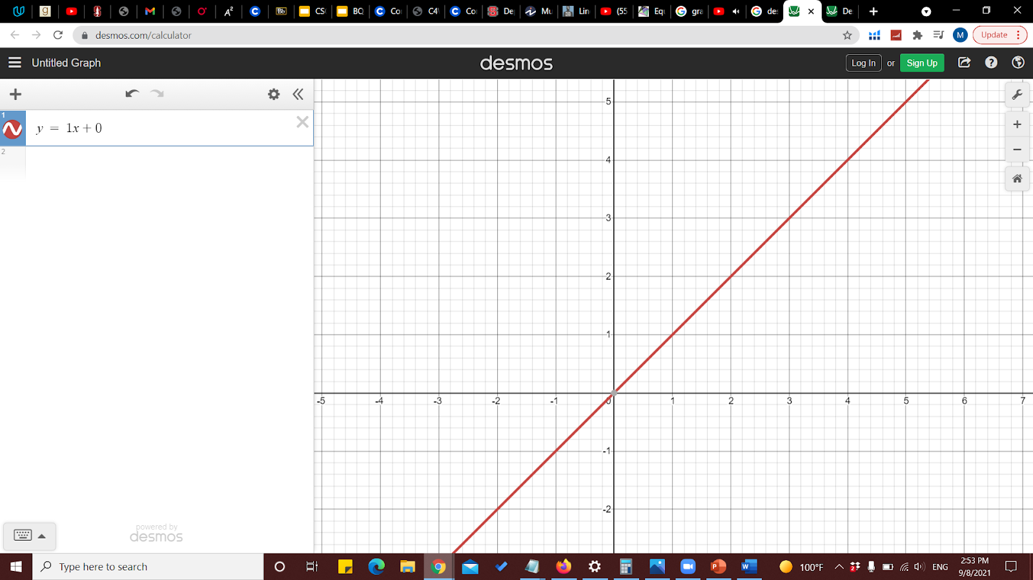
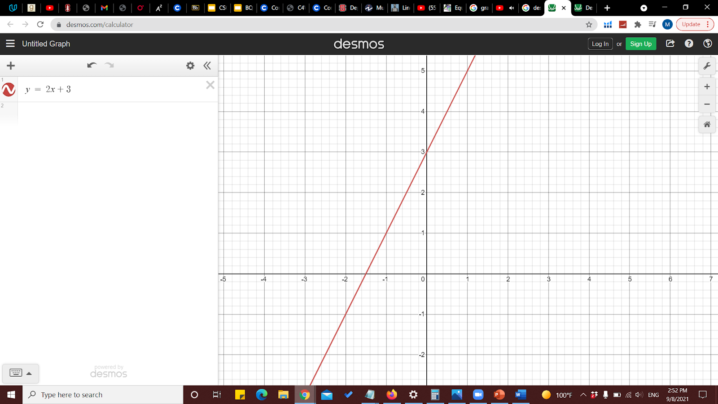
An important equation
Y = mx + b
Y = 1x + 0
Y = 2x + 3

Slide 19
1- put a random line
2- Find how wrong this line is.
3- adjust till we reach a reasonable low error

Slide 21
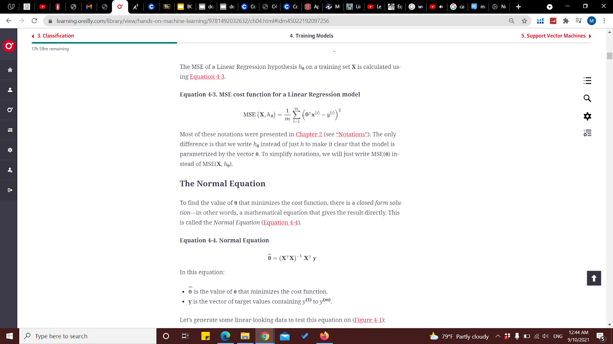
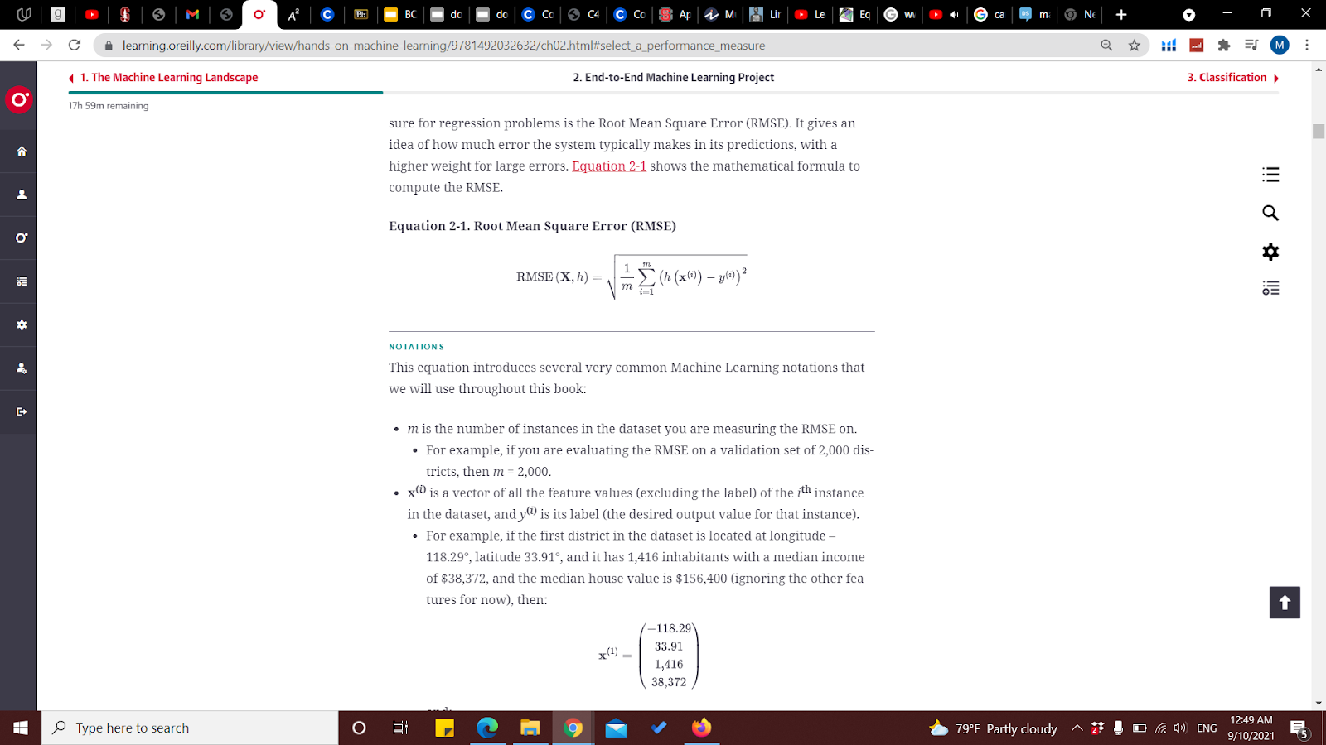
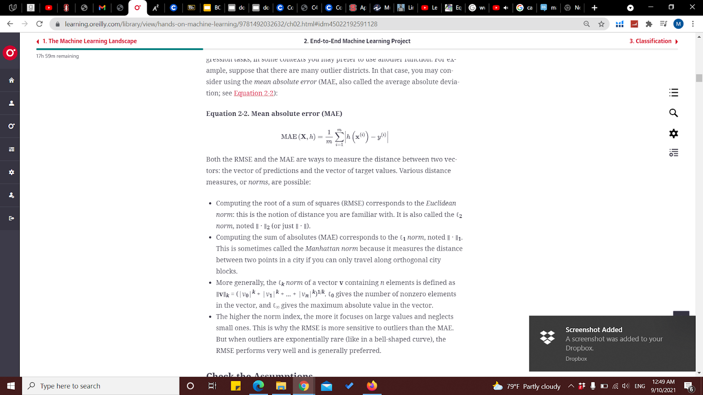
Cost Functions
MSE (mean squared error)
RMSE (root mean squared error)
MAE (mean absolute error)

Slide 22
Gradient descent

Slide 23
3- adjust till we reach a reasonable low error

Slide 24
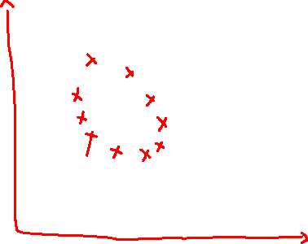

Slide 25
Now deep learning

Slide 26
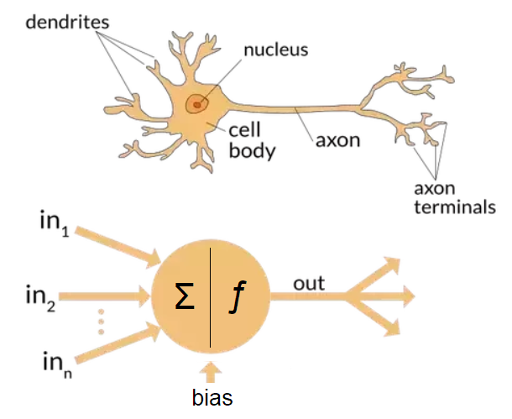
Neurons

Slide 27
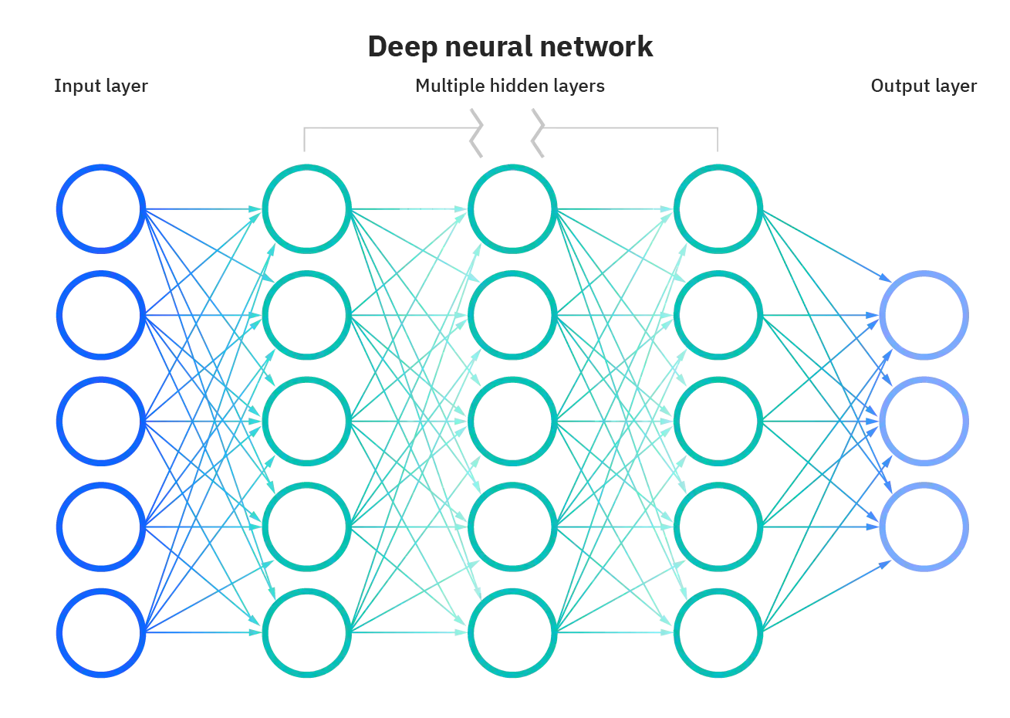
It is a multistage information extraction process

Slide 28
Sequential/Functional APIs notebook:
https://drive.google.com/file/d/1sJjXPjbrs-wr7iymXkW7hciF_I9_7YYF/view?usp=sharing

Slide 29
OCR-mnist dataset

Slide 30
mnist notebook:
https://drive.google.com/file/d/1wwRcKwW1dENkcDDf59jpAncCpQsAmRcc/view?usp=sharing

Slide 31
How do we understand it?

Slide 32
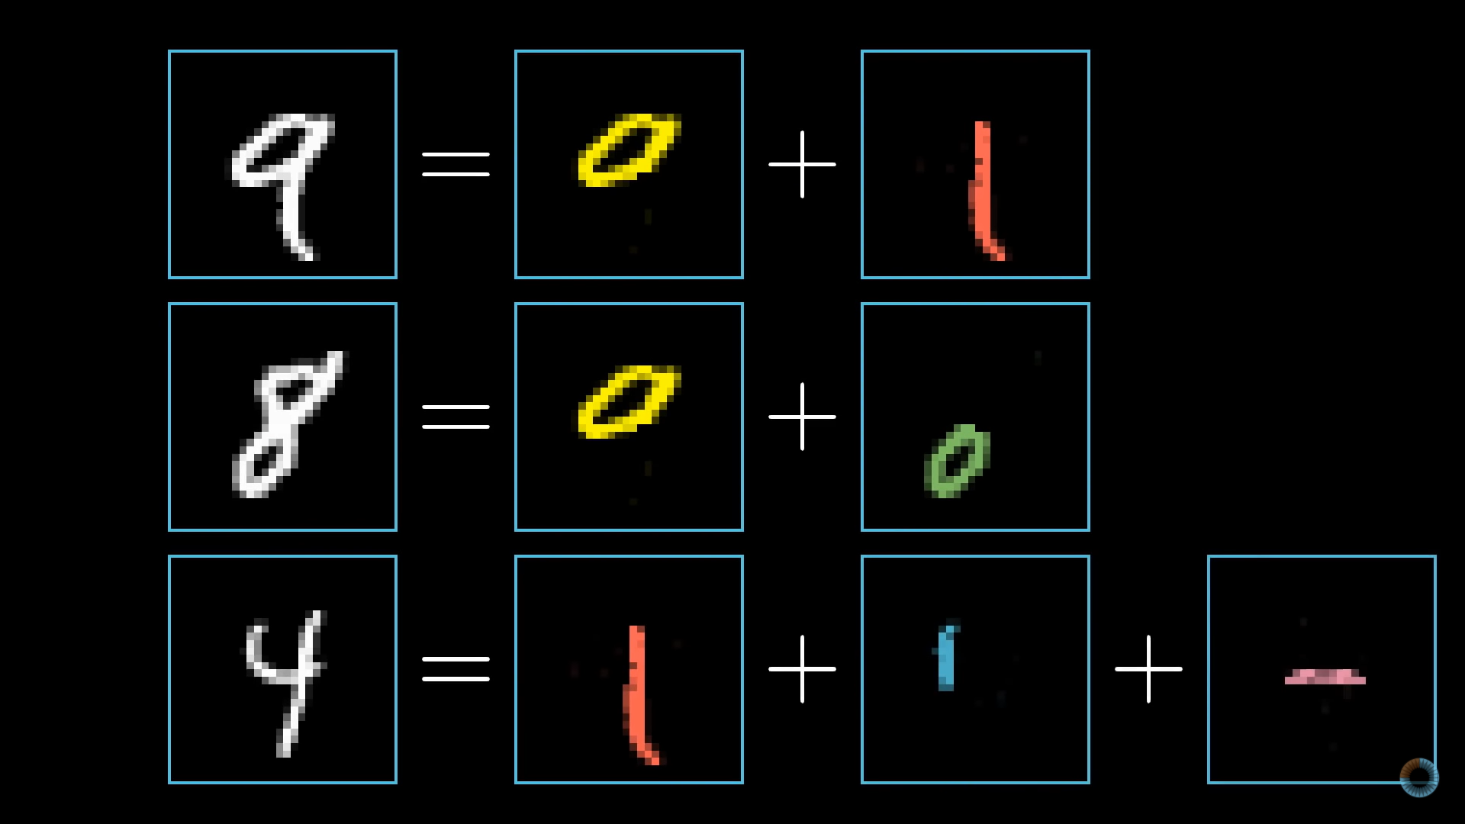
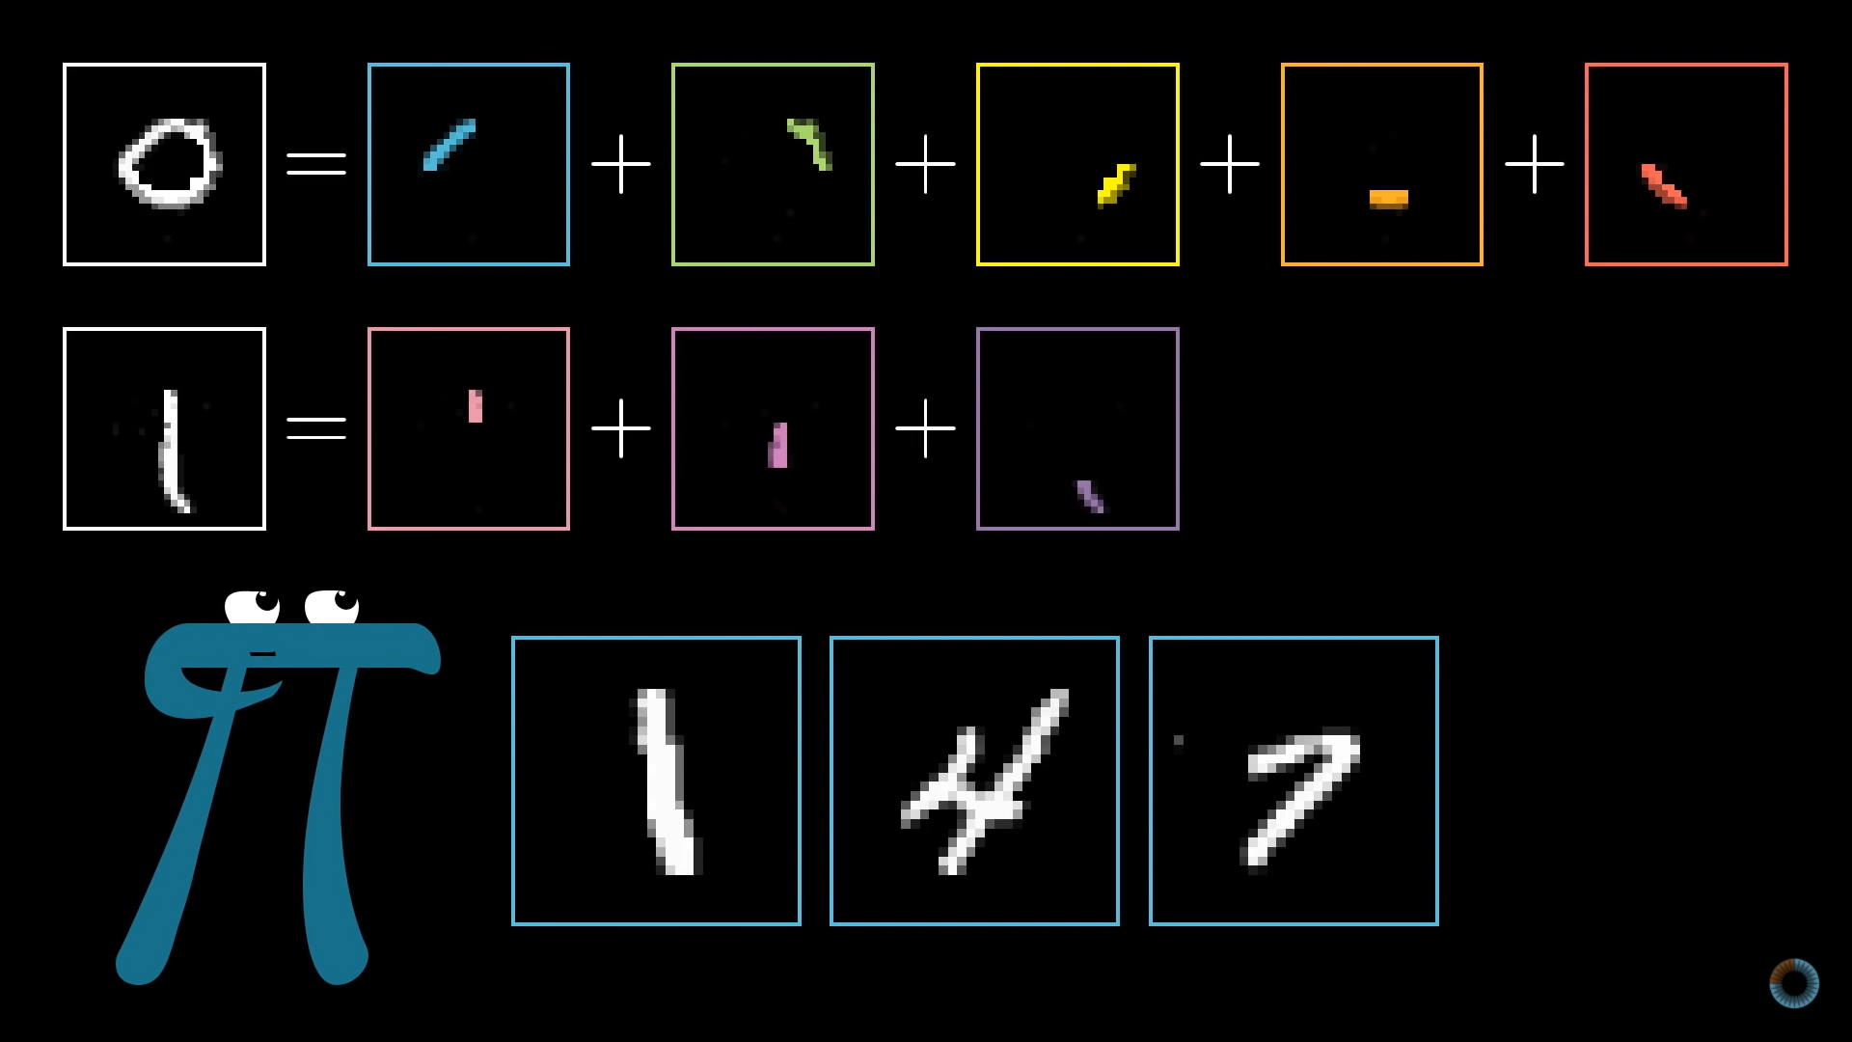
Intuition about what will happen inside the NN

Slide 33
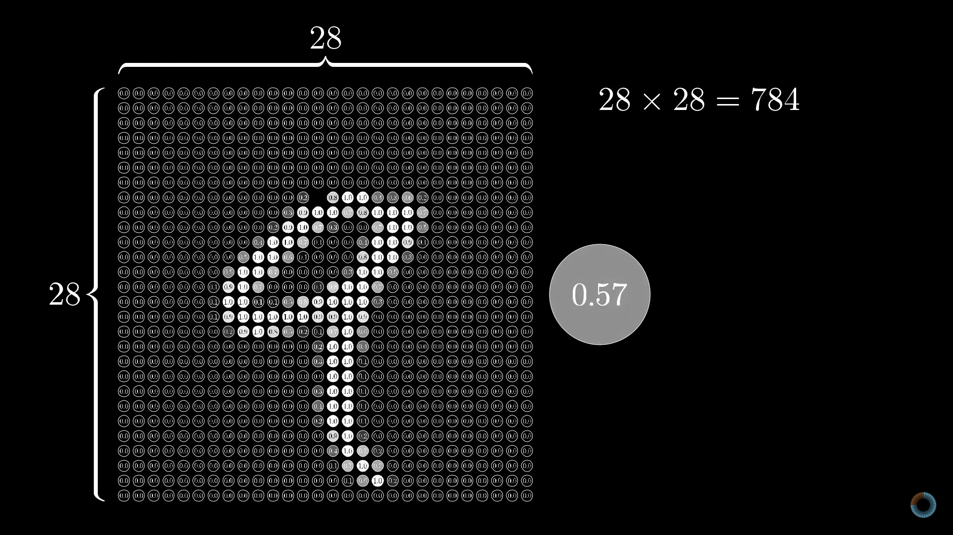
Intuition about what will happen inside the NN
Intuition about what will happen inside the NN

Slide 34
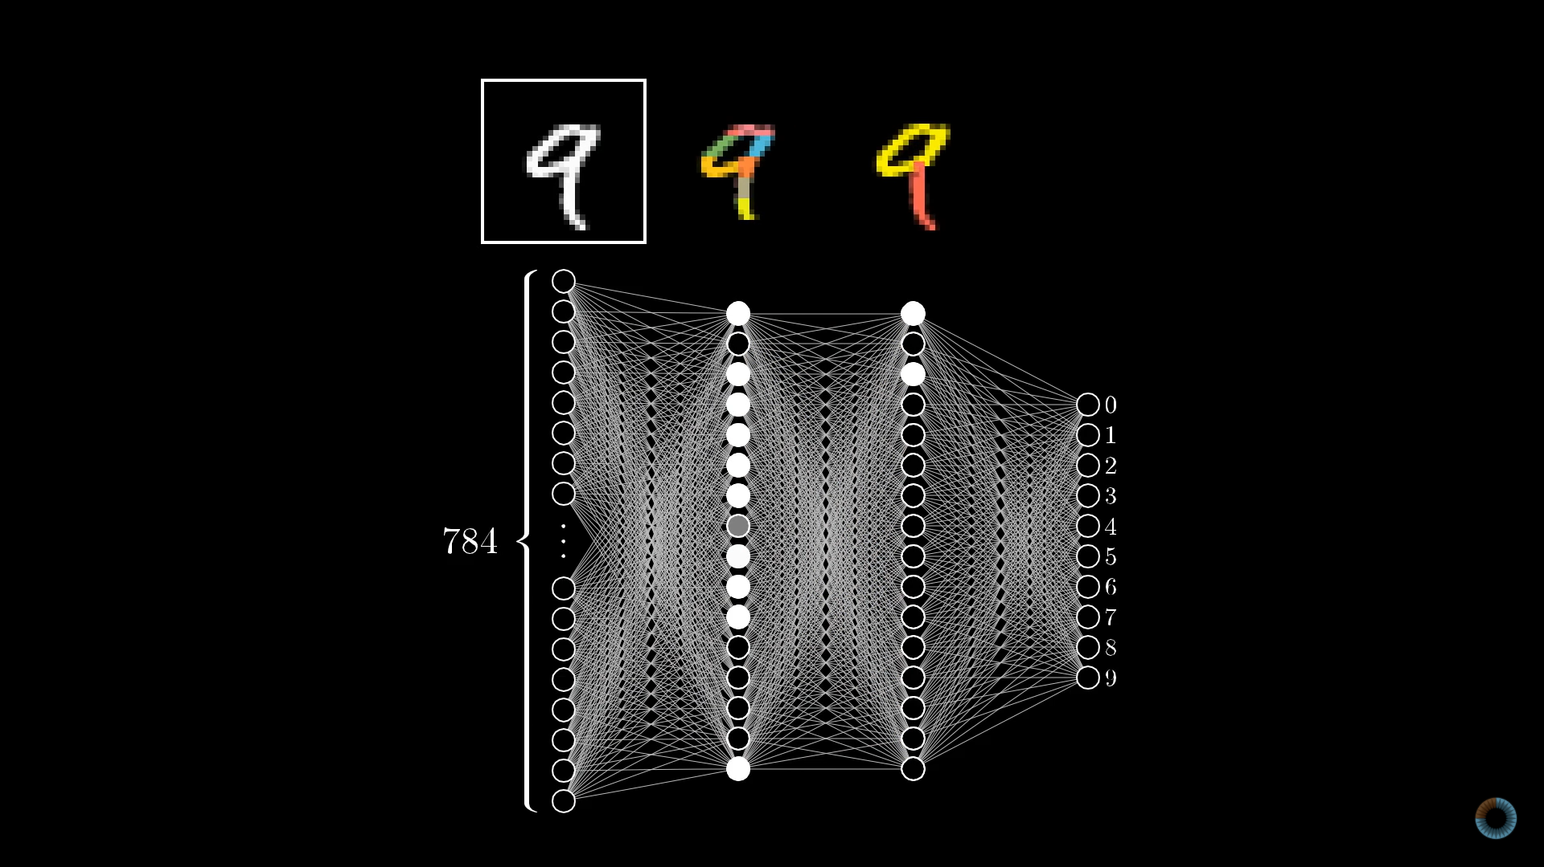
Intuition about what will happen inside the NN

Slide 35
Resources:
https://drive.google.com/file/d/1wwRcKwW1dENkcDDf59jpAncCpQsAmRcc/view?usp=sharing

